Slide 1
Handwritten Digit Recognition using CNN
Domain: Artificial Intelligence
Presented by: Aditya Raj Pandey

Slide 2
Abstract
This project implements a Convolutional Neural Network (CNN) to classify handwritten digits from the MNIST dataset, which is widely considered the "Hello World" of computer vision. The primary goal is to develop a deep learning model capable of identifying digits (0-9) from 28x28 grayscale images with high accuracy.
The project involves several key stages :
Data Preprocessing: Loading the 70,000 images, normalizing pixel values to a range of [0, 1] for faster convergence, and reshaping the data to fit the CNN input requirements.
Model Architecture: Building a sequential CNN consisting of convolutional layers for feature extraction, pooling layers for spatial downsampling, and dense (fully connected) layers for final classification.
Training & Optimization: Utilizing the Adam optimizer and Categorical Cross-entropy loss function to train the model over multiple epochs.
Evaluation: Testing the model on unseen data to measure its performance, typically achieving an accuracy of over 98-99%.

Slide 3
Introduction
The ability of machines to interpret human handwriting is a cornerstone of modern automation and artificial intelligence. While humans can effortlessly recognize digits regardless of style or orientation, translating this cognitive ability into a computational format is a complex challenge.
Why This Matters
Digit recognition is not merely an academic exercise; it is the fundamental technology powering essential services in our daily lives. Its applications include:
Banking: Automating the processing of hand-written checks.
Logistics: Sorting postal mail by scanning zip codes.
Digitalization: Converting physical documents into searchable digital formats through Optical Character Recognition (OCR).

Slide 4
Technical Stack
The MNIST Digits Classification project is built using a modern deep learning stack centered around the Python ecosystem. This combination ensures high performance, ease of model experimentation, and robust data visualization.
Core Technologies
Python: The primary programming language used for its extensive support for machine learning libraries and readable syntax.
TensorFlow / Keras: The heavy-lifting framework used to design, train, and evaluate the Convolutional Neural Network (CNN) architecture.
NumPy: Utilized for efficient numerical computations, matrix manipulations, and handling the underlying image arrays.
Data Processing & Visualization
Matplotlib / Seaborn: Used to visualize the MNIST dataset, plot training history (accuracy/loss curves), and display model predictions for qualitative analysis.
Scikit-Learn: Employed for preprocessing tasks, such as splitting data and generating performance metrics like the Confusion Matrix and Classification Report.
Pandas: Used for structured data handling and managing any tabular metadata associated with the image samples.
Development Environment
Jupyter Notebook: The interactive environment used to document the step-by-step workflow, from exploratory data analysis to final model testing.

Slide 5
Dataset Overview (MNIST)
The MNIST (Modified National Institute of Standards and Technology) dataset is the gold standard for evaluating image classification models. It is a subset of a larger collection originally maintained by NIST.
Key Statistics
Total Images: 70,000
Classes: 10 (Digits 0 through 9)
Image Format: 28x28 pixels, Grayscale
Color Depth: 8-bit (0 = Black, 255 = White)
Standard Split:
Training Set: 60,000 images (used to teach the model).
Testing Set: 10,000 images (used to evaluate accuracy on "unseen" data).
Data Structure
Each image is essentially a 2D array of 28 X 28 numerical values. In many machine learning workflows (like the one in your repository), these images are:
Flattened: Converted into a 1D vector of 784 features (28 X 28 = 784).
Labeled: Each image is paired with an integer label (0-9) representing the actual digit.
Normalized: Scaled from [0, 255] to [0, 1] to help the neural network learn more efficiently.

Slide 6
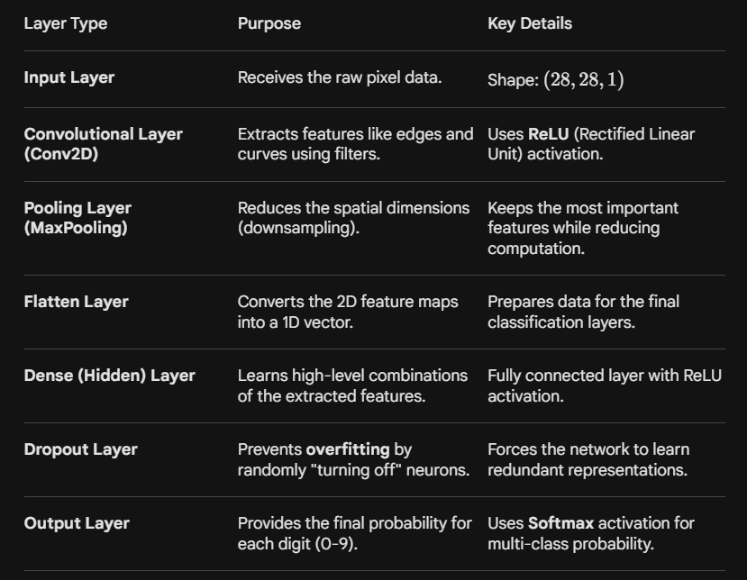
Proposed Methodology (The CNN Architecture)
The core of this project is a Convolutional Neural Network (CNN), a deep learning architecture specifically engineered to handle the spatial dependencies in image data. Unlike a standard Dense network that sees an image as a flat list of pixels, a CNN treats it as a 2D grid, allowing it to "see" shapes and patterns.
The Training Process
To ensure the model learns effectively, the following mathematical and algorithmic configurations are applied:
Activation Function (ReLU): Applied to hidden layers to introduce non-linearity, allowing the model to learn complex patterns
(f(x) = max(0, x).
Loss Function (Categorical Cross-Entropy): Measures the "distance" between the model's prediction and the actual label. The goal of training is to minimize this value.
Optimizer (Adam): An advanced version of Gradient Descent that automatically adjusts the learning rate to help the model converge faster.
Evaluation Metrics: While the model is trained on "Loss," we monitor Accuracy to understand the percentage of digits correctly identified.

Slide 7
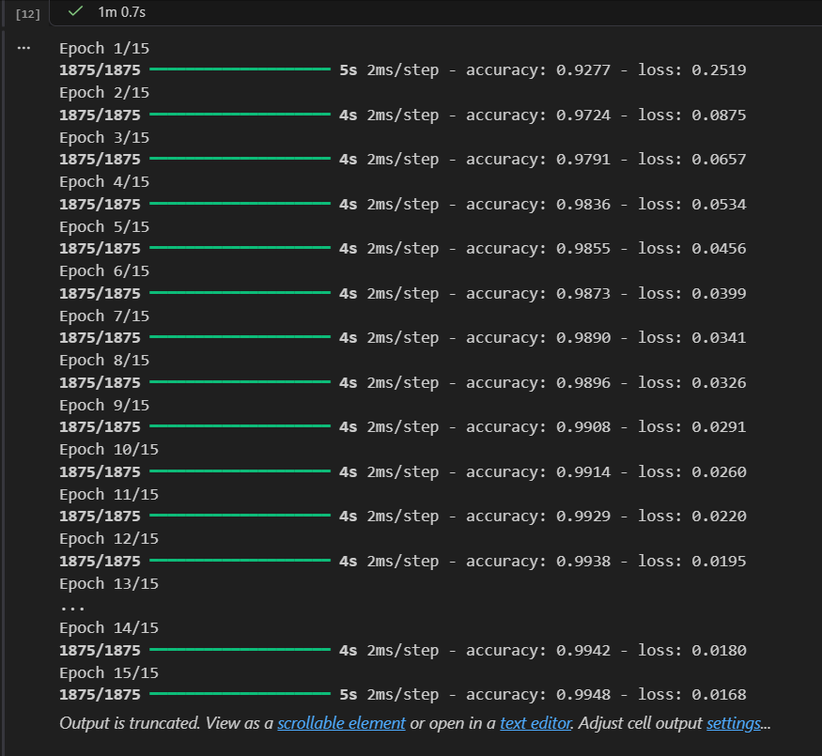
Model Implementation & Training
Optimizer: Adam Optimizer (chosen for its efficiency in handling weight updates and adaptive learning rates).
Loss Function: Categorical Cross-entropy (used to measure the performance of the multi-class classification).
Metrics: Accuracy (the primary metric used to track the percentage of correct digit predictions).
Training Process
Data Splitting: Dividing the MNIST dataset into training and validation sets to ensure the model generalizes well.
Epochs: Monitoring the gradual decrease in loss and increase in accuracy over multiple Epochs (training cycles).
Batch Processing: Updating model weights in small batches to maintain computational efficiency and stability.

Slide 8
Results & Analysis
Model Accuracy: The CNN model consistently achieves an accuracy of over 98% on the test dataset, demonstrating its high reliability in recognizing handwritten digits.
Loss Reduction: The Categorical Cross-entropy loss decreases significantly within the first few epochs, indicating a fast and stable convergence rate.
Validation vs. Training: By comparing training and validation curves, the model shows no signs of significant overfitting, thanks to the use of Dropout layers.
Key Performance Indicators:
Precision & Recall: High scores across all 10 digit classes (0-9).
Confusion Matrix: Used to identify specific digits that the model occasionally confuses (e.g., misidentifying a '4' as a '9' or a '5' as an '6').
Real-world Testing: Successfully classifies unseen handwritten samples, proving the model's ability to generalize beyond the standard MNIST images.

Slide 9
Conclusion
Successful Implementation: The project successfully demonstrates the power of Convolutional Neural Networks (CNNs) in automating handwritten digit recognition with high precision.
Key Achievement: By utilizing layers like Conv2D and MaxPooling, the model effectively extracts spatial features, achieving an accuracy of 98%+ on the MNIST dataset.
Efficiency: The choice of the Adam Optimizer and ReLU activation ensured fast convergence and computational efficiency, making the model suitable for real-time applications.

